Slide 1
Introduction to Artificial Neural Networks
Artificial Neural Networks (ANNs) are computer systems designed to mimic how the human brain processes information.
Just like the brain uses neurons to process data and make decisions, ANNs use artificial neurons to analyze data, identify patterns and make predictions.
These networks consist of layers of interconnected neurons that work together to solve complex problems.
The key idea is that ANNs can "learn" from the data they process, just as our brain learns from experience.

Slide 2
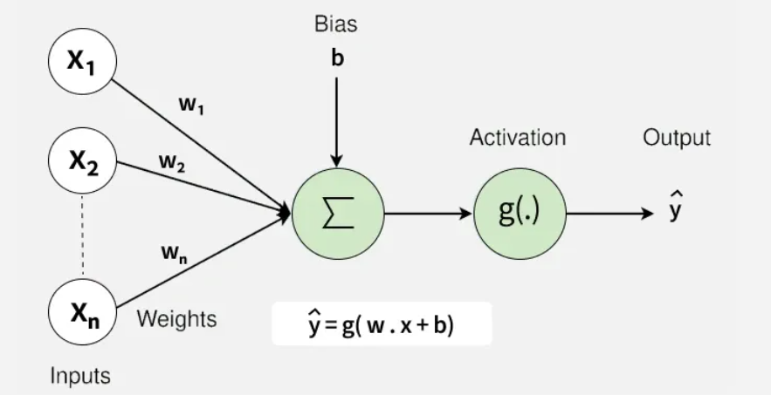
Introduction to Artificial Neural Networks

Slide 3
Neural networks: key components
Neurons: The basic units that receive inputs, each neuron is governed by a threshold and an activation function.
Connections: Links between neurons that carry information, regulated by weights and biases.
Weights and Biases: These parameters determine the strength and influence of connections.
Propagation Functions: Mechanisms that help process and transfer data across layers of neurons.
Learning Rule: The method that adjusts weights and biases over time to improve accuracy.

Slide 4
Introduction to Artificial Neural Networks
Learning in neural networks follows a structured, three-stage process
Input Computation: Data is fed into the network.
Output Generation: Based on the current parameters, the network generates an output.
Iterative Refinement: The network refines its output by adjusting weights and biases, gradually improving its performance on diverse tasks.
In an adaptive learning environment:
The neural network is exposed to a simulated scenario or dataset.
Parameters such as weights and biases are updated in response to new data or conditions.
With each adjustment, the network’s response evolves allowing it to adapt effectively to different tasks or environments.

Slide 5
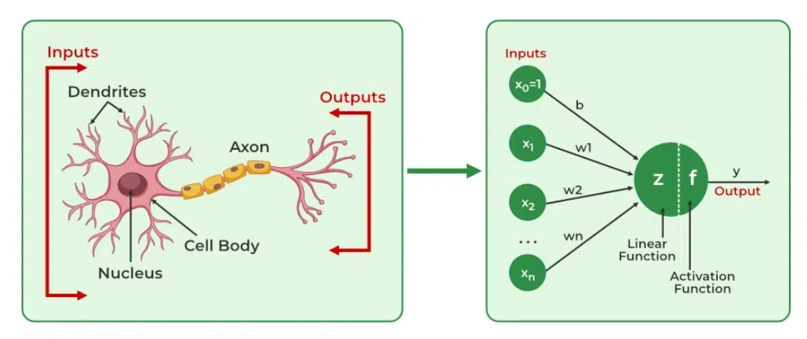
Biological Neuron - Artificial Neural Networks

Slide 6
Biological Neuron
It is composed of a cell body containing
Nucleus and most of the cell’s complex components
Many branching extensions called dendrites
One very long extension called the axon
The axon’s length may be just a few times longer than the cell body, or up to tens of thousands of times longer.
Near its extremity the axon splits off into many branches called telodendria
At the tip of these branches are minuscule structures called synaptic terminals (or simply synapses), which are connected to the dendrites or cell bodies of other neurons.

Slide 7
Biological Neuron
Biological neurons produce short electrical impulses called action potentials (APs, or just signals) which travel along the axons and make the synapses release chemical signals called neurotransmitters.
When a neuron receives a sufficient amount of these neurotransmitters within a few milliseconds, it fires its own electrical impulses (actually, it depends on the neurotransmitters, as some of them inhibit the neuron from firing).
They are organized in a vast network of billions, with each neuron typically connected to thousands of other neurons.
Highly complex computations can be performed by a network of fairly simple neurons

Slide 8
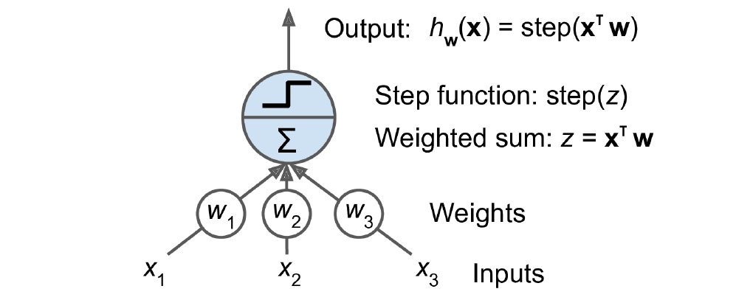
Perceptron
(y)
y
Threshold logic unit: an artificial neuron which computes a weighted sum of its inputs then applies a step function

Slide 9
Perceptron
Perceptron is one of the simplest ANN architectures, invented in 1957 by Frank Rosenblatt.
It is based on a slightly different artificial neuron called a threshold logic unit (TLU), or sometimes a linear threshold unit (LTU).
The inputs and output are numbers, and each input connection is associated with a weight.
The TLU computes a weighted sum of its inputs
Y = w₁ x₁+ w₂ x₂ + ⋯ + w_{n}x_{n} = x⊺w
Then applies a step function to that sum and outputs the result:
h_{w}(x) = step(y), where Y = x⊺w.

Slide 10
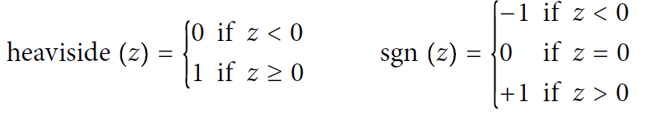
Perceptron
Common step functions used in Perceptron (assuming threshold =0)
A single TLU can be used for simple linear binary classification. It computes a linear combination of the inputs, and if the result exceeds a threshold, it outputs the positive class. Otherwise, it outputs the negative class (just like a Logistic Regression or linear SVM classifier)
For example, use a single TLU to classify iris flowers based on petal length and width (also adding an extra bias feature x0 = 1)
Training a TLU in this case means finding the right values for w0, w1, and w2

Slide 11
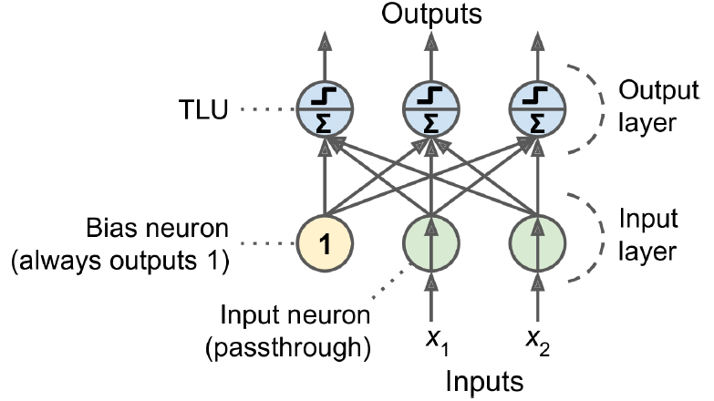
Perceptron
Architecture of a Perceptron with two input neurons, one bias neuron, and three output neurons

Slide 12
Perceptron
A Perceptron is simply composed of a single layer of TLUs, with each TLU connected to all the inputs.
When all the neurons in a layer are connected to every neuron in the previous layer (i.e., its input neurons), the layer is called a fully connected layer, or a dense layer.
The inputs of the Perceptron are fed to special passthrough neurons called input neurons: they output whatever input they are fed. All the input neurons form the input layer.
An extra bias feature is generally added (x0 = 1): it is typically represented using a special type of neuron called a bias neuron, which outputs 1 all the time.
This Perceptron can classify instances simultaneously into three different binary classes, which makes it a multioutput classifier.

Slide 13
Perceptron
Computing the outputs of a fully connected layer
h_{W, b}(X) = ϕ(XW + b)
X represents the matrix of input features. It has one row per instance and one column per feature.
The weight matrix W contains all the connection weights except for the ones from the bias neuron. It has one row per input neuron and one column per artificial neuron in the layer.
The bias vector b contains all the connection weights between the bias neuron and the artificial neurons. It has one bias term per artificial neuron.
The function ϕ is called the activation function: when the artificial neurons are TLUs, it is a step function.

Slide 14
Perceptron
A Perceptron is a type of artificial neuron, introduced by Frank Rosenblatt in 1958.
A perceptron takes several inputs, applies weights to them, adds a bias, and then passes the result through an activation function to produce an output.
A Perceptron is the most fundamental unit of an artificial neural network, which is widely used in machine learning and artificial intelligence.
It is inspired by the functioning of a biological neuron and is used to perform binary classification—that is, to decide whether something belongs to one class or another (e.g., yes/no, true/false, safe/unsafe).

Slide 15
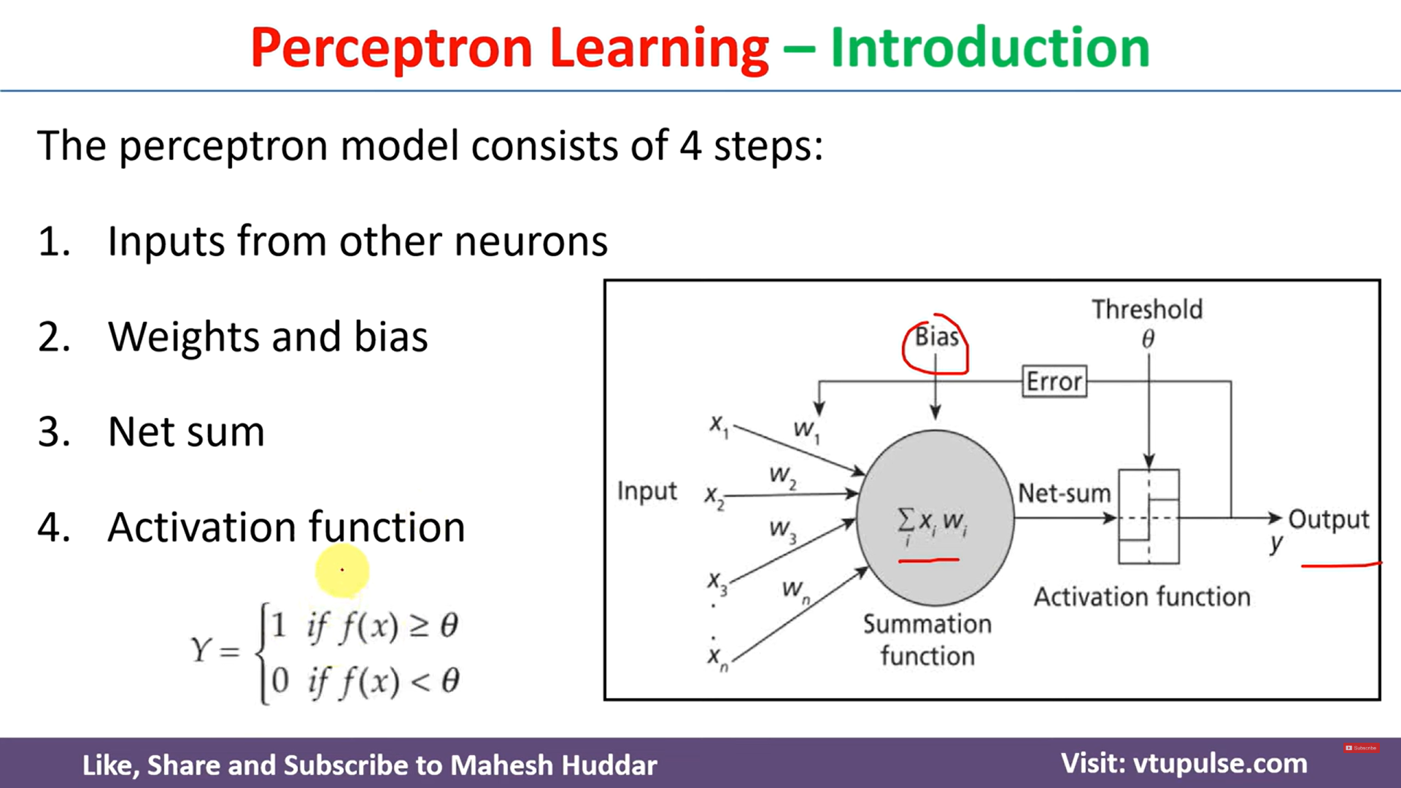

Slide 16
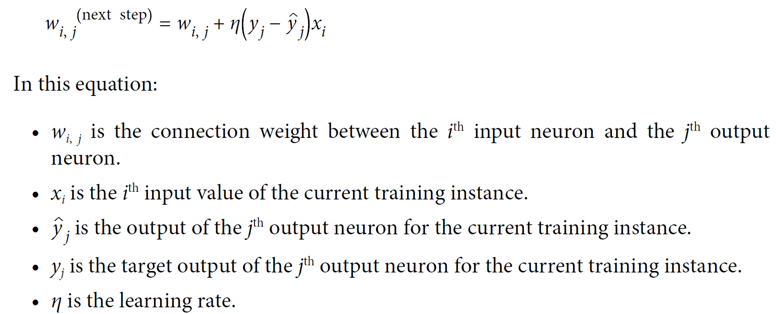
Perceptron learning rule (weight update)

Slide 17
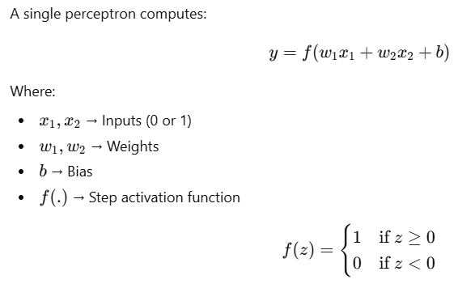
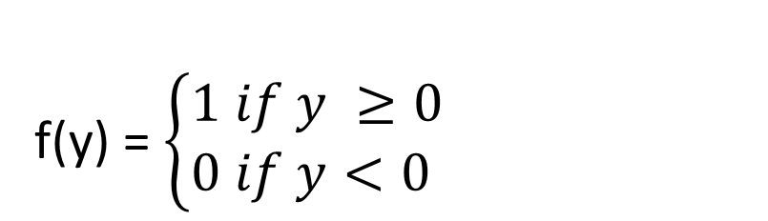
Single Perceptron
f(y) = $\left\{\begin{aligned}1 if y ≥0 \\ 0 if y<0 \end{aligned}\right.$

Slide 18
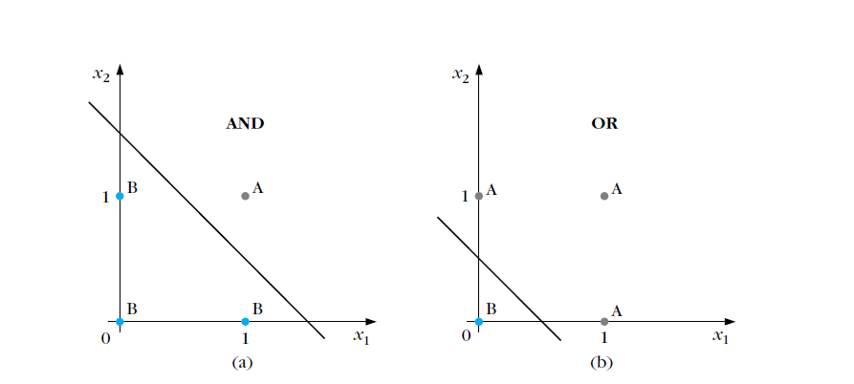
Example for one layer Perceptron
Can Solve Only Linearly Separable Problems

Slide 19
PYQ:
Illustrate how the perceptron learning algorithm can be used to solve the two-input AND gate problem. Use the following settings:
i)Learning rate=1
ii)All initial weights bias are zero
iii)show calculations for at least two epochs or until the perceptron converges.

Slide 20
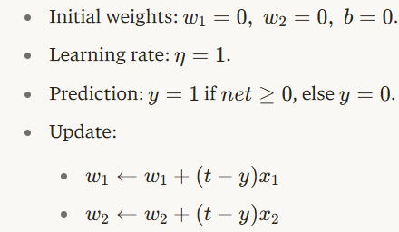

Slide 21
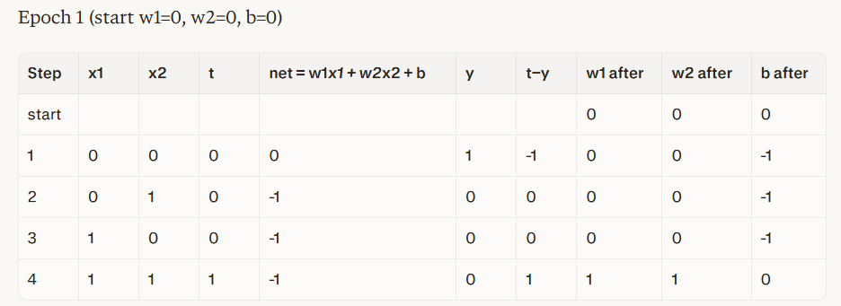
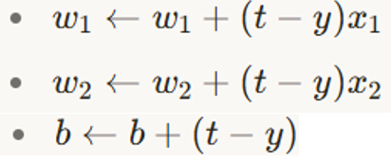

Slide 22
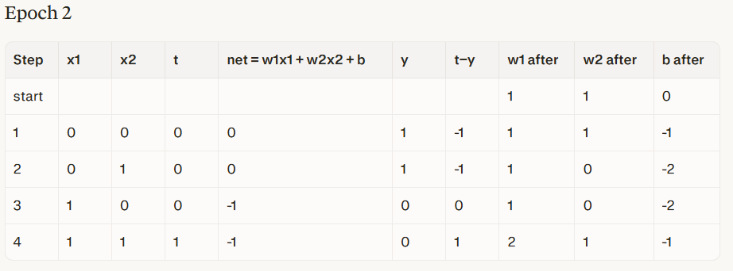

Slide 23
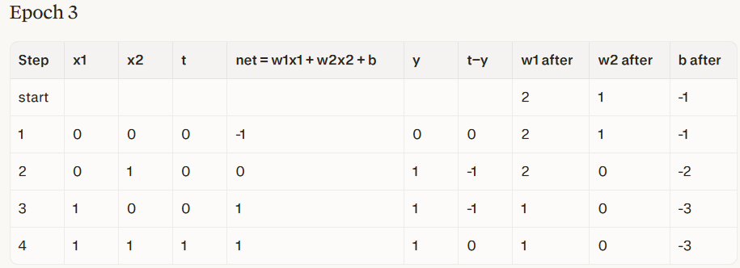

Slide 24
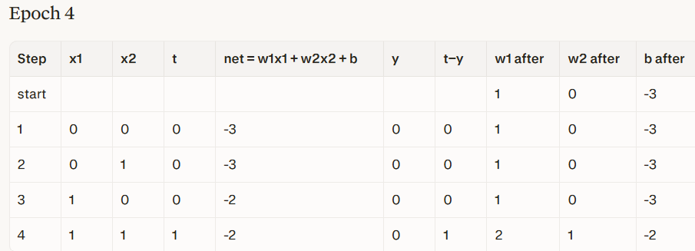

Slide 25
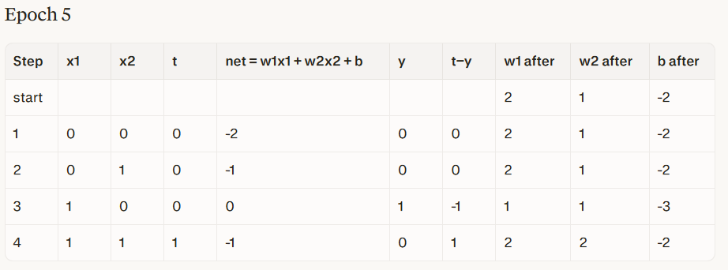

Slide 26
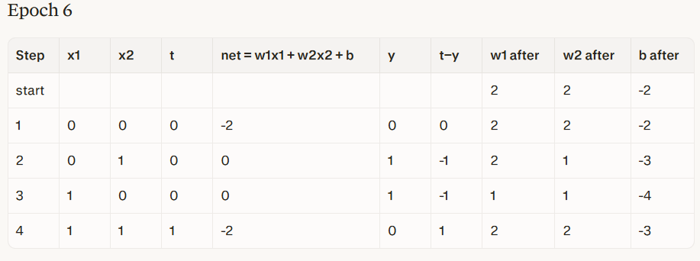

Slide 27
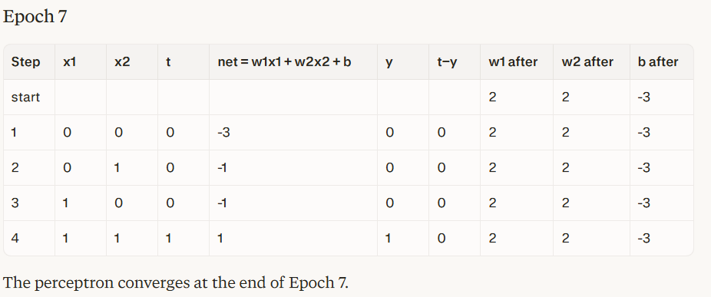
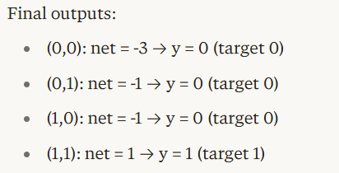

Slide 28
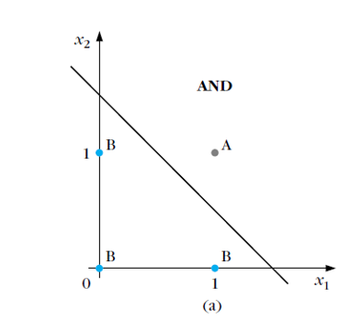
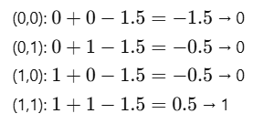
Perceptron Learning Algorithm (Training Method) – AND GATE
Verify for the input
x1 + x2 - 1.5 = 0

Slide 29
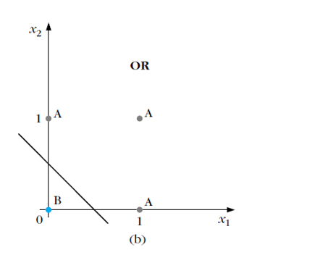
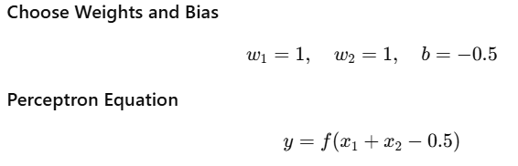
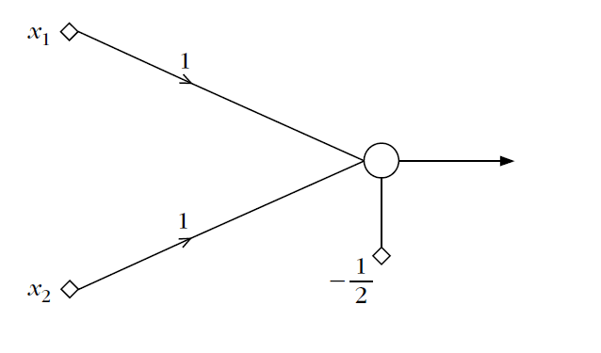
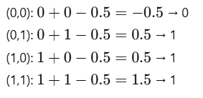
OR Gate Using Single Perceptron
Truth Table
x₁ | x₂ | O/P | Class
0 | 0 | 0 | B
0 | 1 | 1 | A
1 | 0 | 1 | A
1 | 1 | 1 | A

Slide 30
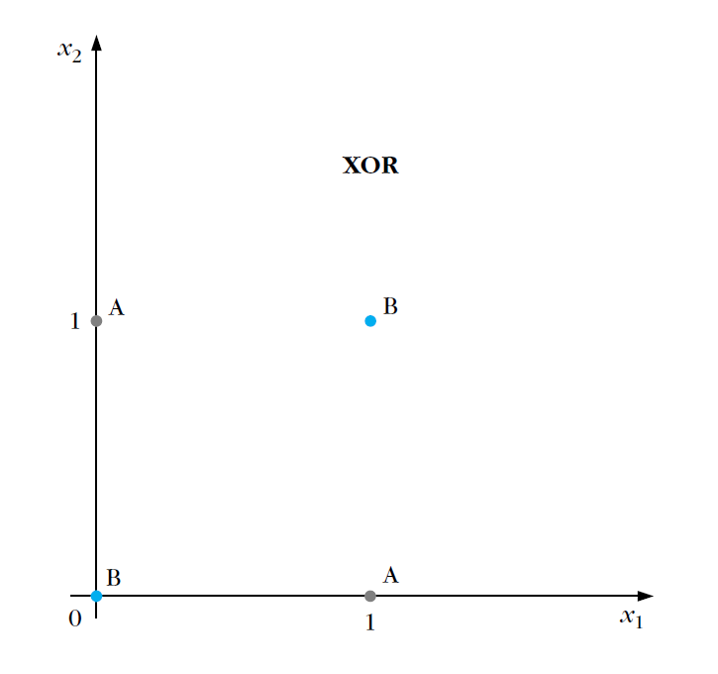
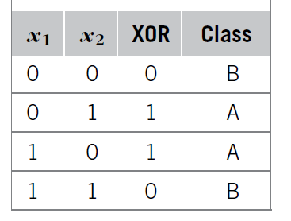
Limitations of one layer Perceptron
It cannot solve non-linearly separable problems.
Example (XOR Problem – Does NOT Work)

Slide 31
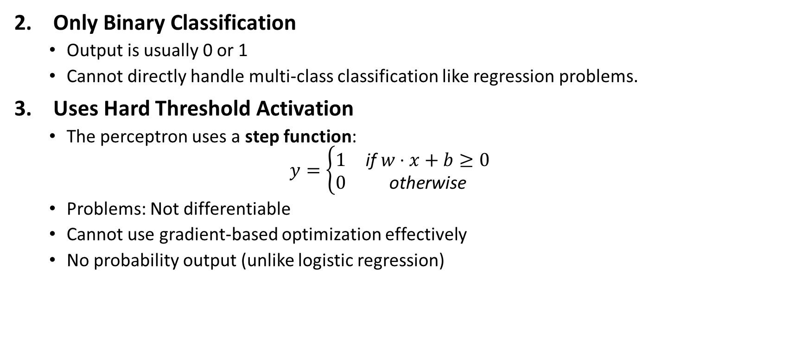
Limitations of one layer Perceptron
Only Binary Classification
Output is usually 0 or 1
Cannot directly handle multi-class classification like regression problems.
Uses Hard Threshold Activation
The perceptron uses a step function:
$$y=\left\{\begin{matrix}1 & \text{if} w⋅x+b≥0 \\ 0 & \text{otherwise}\end{matrix}\right.$$
Problems: Not differentiable
Cannot use gradient-based optimization effectively
No probability output (unlike logistic regression)

Slide 32
Limitations of one layer Perceptron
No Hidden Layer (Limited Learning Capacity)
No nonlinear activation in between/ It cannot learn complex patterns or feature interactions.
Sensitive to Learning Rate and Initialization
If data is not linearly separable → training may never converge.
If learning rate is too high → unstable updates.
If too low → very slow convergence.
No Feature Learning
It cannot automatically extract new features.
Works only with manually engineered input features.
Cannot Model Complex Decision Boundaries
Real-world problems often require curved boundaries, multiple regions and hierarchical feature learning
Single-layer perceptron cannot handle these.

Slide 33
Limitations of one layer Perceptron were overcome by
Multi-Layer Perceptron (MLP)
Hidden layers
Non-linear activation functions (ReLU, Sigmoid, Tanh)
Backpropagation algorithm

Slide 34
Universal Approximation Theorem (UAT)
The Universal Approximation Theorem states:
A feedforward neural network with at least one hidden layer containing a sufficient number of neurons and using a nonlinear activation function can approximate any continuous function on a bounded domain to any desired level of accuracy.
If enough hidden neurons are available, a neural network can learn almost any complex relationship between inputs and outputs.
Examples: Image recognition, Speech recognition, Weather prediction, Stock prediction, Medical diagnosis, Language translation

Slide 35
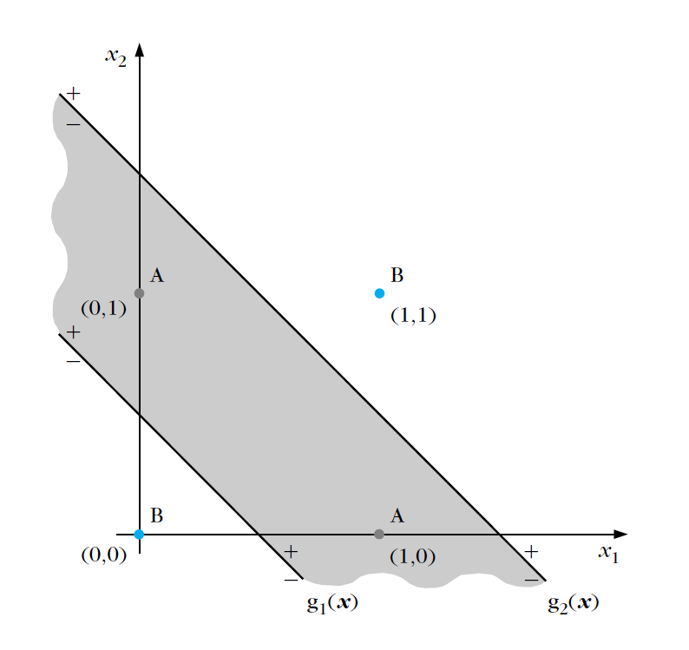
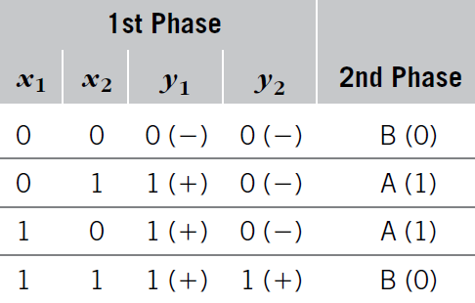
XOR problem - TWO-LAYER PERCEPTRON

Slide 36
XOR problem - TWO-LAYER PERCEPTRON
Two phase of decision
Perform a mapping of the input vector x to a new one y [ y1, y2]^{T}.
Transformed data
[ y1, y2][0, 0] and [ y1, y2][1, 1], which correspond to class B vectors,
[ y1, y2][1, 0], which correspondsto class A vectors.
Mapping of the first phase transforms the nonlinearly separable problem to a linearly separable one.

Slide 37
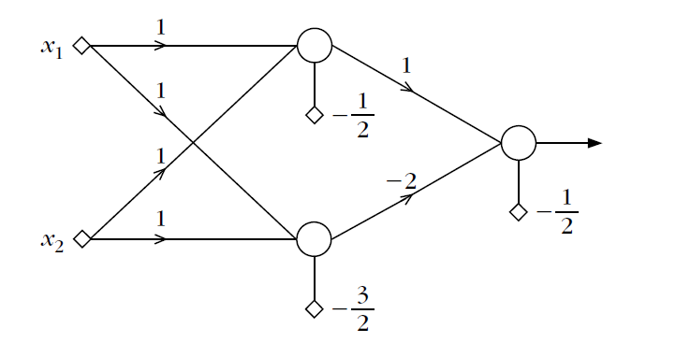
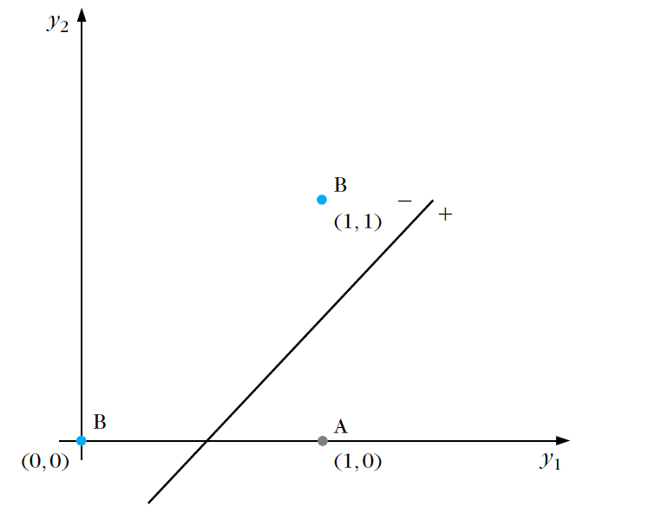
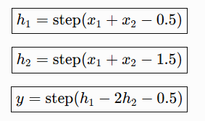
XOR problem - TWO-LAYER PERCEPTRON
Two-layer perceptron two-layer feedforward neural network

Slide 38
XOR problem - TWO-LAYER PERCEPTRON
The two neurons (nodes) of the first layer perform computations of the first phase and they constitute the so-called hidden layer.
The single neuron of the second layer performs the computations of the final phase and constitutes the output layer.
Input layer corresponds to the (nonprocessing) nodes where input data are applied. Thus, the number of input layer nodes equals the dimension of the input space.
The lines that are realized by the two-layer perceptron

Slide 39
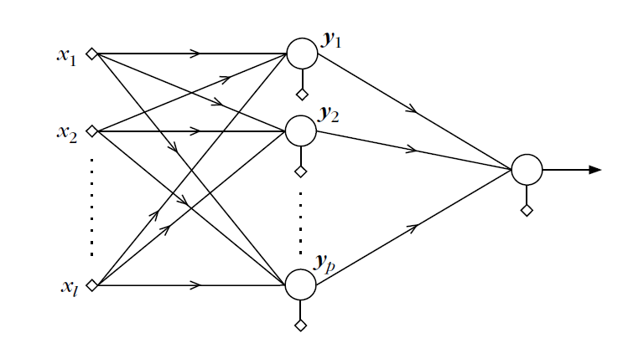
A two-layer perceptron

Slide 40
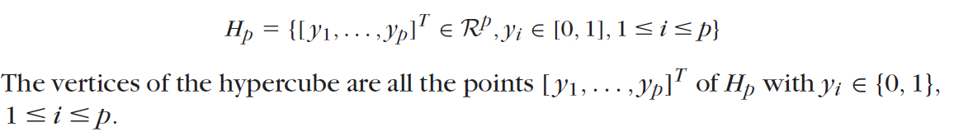
A two-layer perceptron
Input vectors in the l-dimensional space, that is, x ∈ R^{l} , and p neurons in the hidden layer
Hypercube of unit side length in the p-dimensional space, denoted by Hp.
The mapping of the input space onto the vertices of the hypercube is achieved via the creation of p hyperplanes. Each of the hyperplanes is created by a neuron in the hidden layer, and the output of each neuron is 0 or 1, depending on the relevant position of the input vector with respect to the corresponding hyperplane.

Slide 41
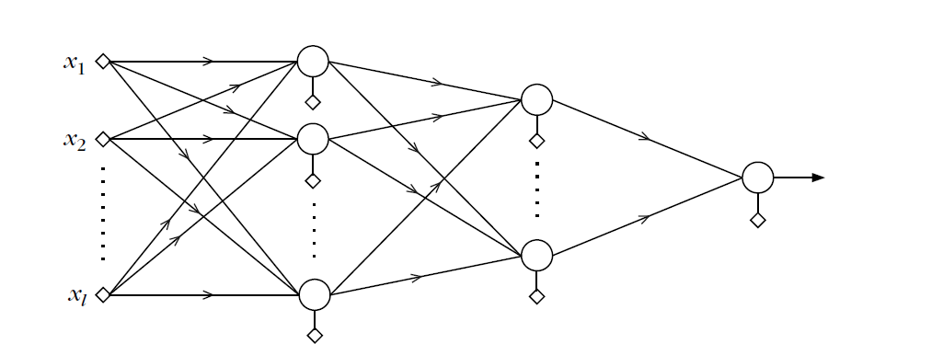
THREE-LAYER PERCEPTRONS
The inability of the two-layer perceptron to separate classes resulting from any union of polyhedral regions springs from the fact that the output neuron can realize only a single hyperplane. The difficulty was overcome by constructing two lines instead of one.

Slide 42
THREE-LAYER PERCEPTRONS
Three-layer perceptron architecture with two layers of hidden neurons and one output layer.
P neurons of the first hidden layer, which perform the mapping of the input space onto the vertices of the Hp hypercube of unit side length
Class A consists of the union of K of the resulting polyhedra and class B of the rest
Use K neurons in the second hidden layer. Each of these neurons realizes a hyperplane in the p-dimensional space. The synaptic weights for each of the second-layer neurons are chosen so that the realized hyperplane leaves only one of the Hp vertices on one side and all the rest on the other.
For each neuron a different vertex is isolated, that is, one of the K A class vertices
Each time an input vector from class A enters the network, one of the K neurons of the second layer results in a 1 and the remaining K -1 give 0
For class B vectors all neurons in the second layer output a 0.
Choose the output layer neuron to realize an OR gate. Its output will be 1 for class A and 0 for class B vectors.

Slide 43
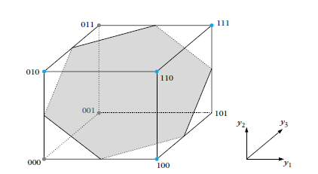
THREE-LAYER PERCEPTRONS
class A consists of the union of the regions mapped onto vertices 000, 001, 011
class B consists of the rest
The neurons of the first hidden layer map an input vector onto one of the vertices of a unit (hyper)cube. The output neuron realizes a (hyper)plane to separate vertices according to their class label.

Slide 44
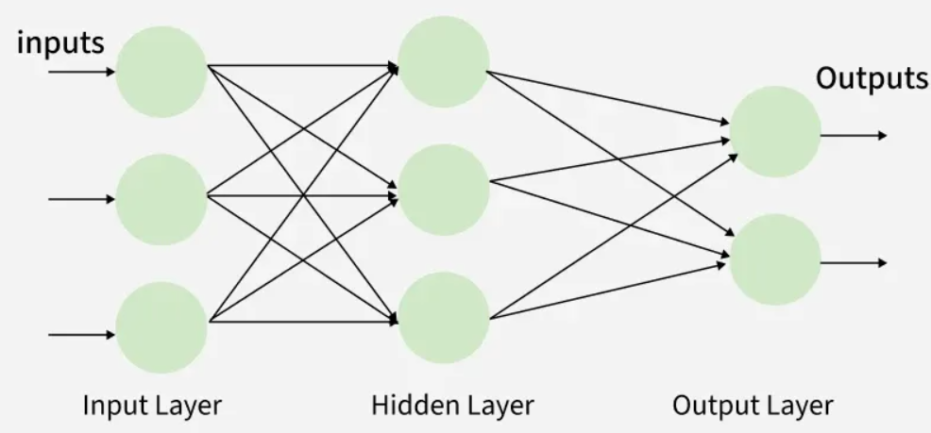
Multilayer perceptron (MLPs)
A Multi-Layer Perceptron (MLP) consists of:
Input Layer: receives raw data
One or more Hidden Layers: extracts features
Output Layer: produces final predictions

Slide 45
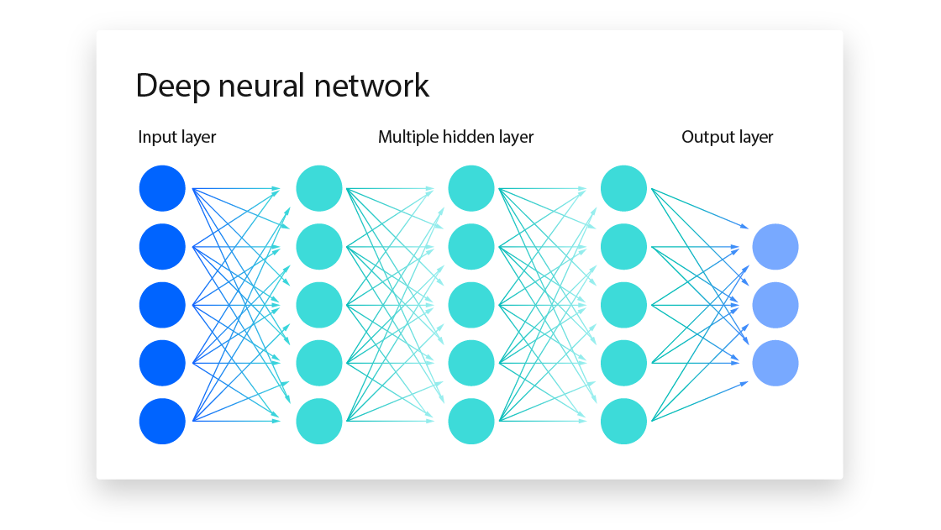
DEEP NEURAL NETWORKS

Slide 46
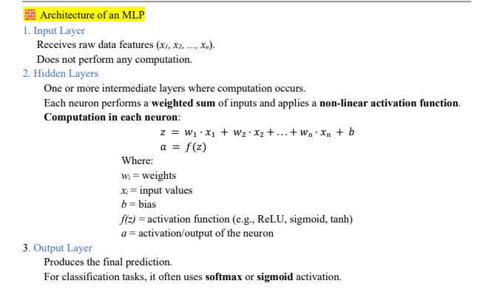

Slide 47
Activation Functions
Activation function decide whether a neuron should be activated or not.
It helps the network to use the useful information and suppress the irrelevant information.
Usually a nonlinear function.
What if we choose a linear?
Linear classifier
Limited capacity to solve complex problems.

Slide 48
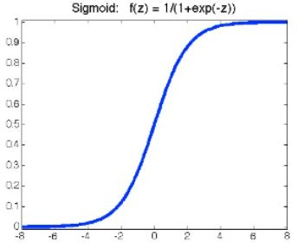


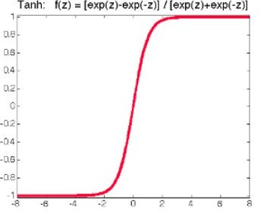
Activation Functions
Sigmoid
continuously differentiable
ranges from 0-1
not symmetric around the origin
Tanh
○
○
scaled version of the sigmoid
symmetric around the origin
vanishing gradient

Slide 49
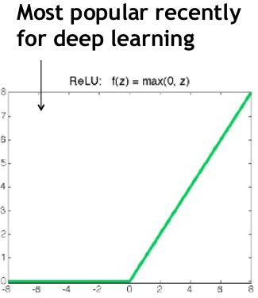

Activation Functions (cont’d)
ReLU
Also called piecewise linear function because rectified function is linear for half of the input domain and nonlinear for the other half.
trivial to implement
sparse representation
avoid the problem of vanishing gradients
dead neurons

Slide 50
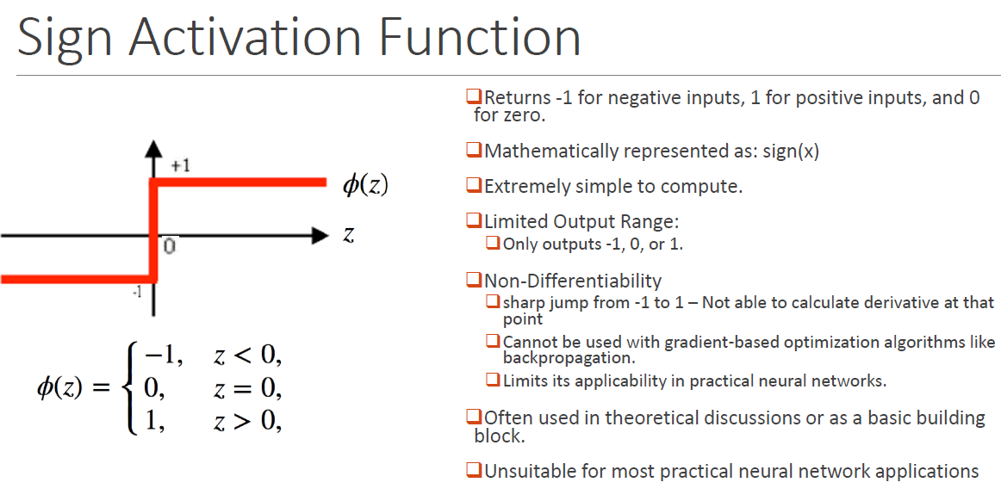
Activation Functions

Slide 51
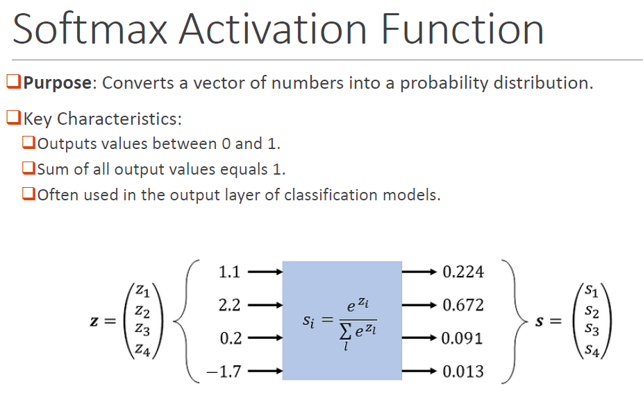
Activation Functions

Slide 52
Artificial Neural Networks Algorithm
1. Initialize Weights and Bias
The algorithm starts by initializing the weights i.e the strength of connections between neurons and biases which is additional parameters that help to adjust output. These values are usually initialized randomly.
Set the learning rate (α) which controls how much the weights should be adjusted during training.
2. Feed Input Data
The input data is fed into the input layer of the network. Each input is a feature like an image pixel, a value from a dataset, etc.

Slide 53
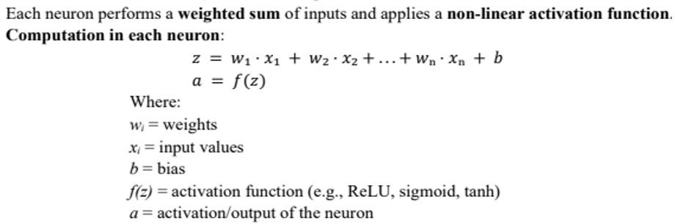
Artificial Neural Networks Algorithm
3. Forward Propagation (Calculate Output)
The data is passed through the network from the input layer to the hidden layers and finally to the output layer. At each layer the input is multiplied by the weights and passed through an activation function like sigmoid, ReLU, etc to produce the output of that layer. The result is a prediction or an output that is compared to the actual target value.

Slide 54
Artificial Neural Networks Algorithm
4. Calculate Error
Once the network has made a prediction the next step is to calculate the error i.e the difference between the predicted output and the actual target.
This error is often measured using a loss function like Mean Squared Error or Cross-Entropy.
Error = t – y where the target output and y is the predicted output
5. Backpropagation (Update Weights)
Backpropagation computes the gradients i.e how much change in weights would reduce the error by using the chain rule of calculus.
The weights and biases are then updated to minimize the error. The update is done using an optimization algorithm like Gradient Descent

Slide 55
Artificial Neural Networks Algorithm
6. Repeat (Epochs)
Steps 2 to 5 are repeated for multiple epochs which is iterations over the entire training dataset. During each epoch the weights are adjusted to reduce the error gradually.
7. Test the Network
After training, the network is tested with new data to evaluate its performance. If the accuracy is good, the training is considered complete. If not more training or adjustments may be needed.

Slide 56
Demonstration of Regression and Classification Problems using MLP
Regression using MLP:
Objective: To predict a continuous numerical value.
Output Layer Configuration: For regression tasks, the MLP's output layer typically consists of a single neuron. This neuron is generally equipped with a linear activation function (or sometimes no explicit activation function, simply outputting the raw weighted sum). A linear activation allows the neuron to output any real number, which is necessary for predicting continuous values.
Loss Function: Common loss functions for regression problems quantify the difference between the predicted continuous value and the actual target value. Examples include:
Mean Squared Error (MSE): Calculates the average of the squared differences between predicted and actual values. It heavily penalizes larger errors.
Mean Absolute Error (MAE): Calculates the average of the absolute differences between predicted and actual values. It is less sensitive to outliers than MSE.

Slide 57
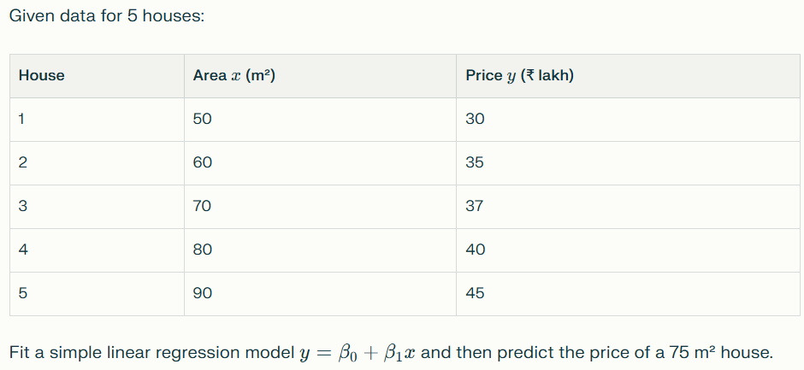
Demonstration of Regression Problems using MLP

Slide 58
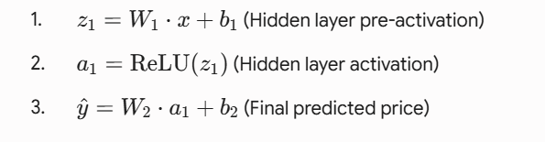
Demonstration of Regression Problems using MLP
The Forward Pass Walkthrough

Slide 59
Classification using MLP:
Example: An MLP could be trained to predict whether a credit card transaction is fraudulent or legitimate. The single output neuron, with a sigmoid activation, would output a probability (e.g., 0.98 for fraudulent, meaning a 98% chance of being fraudulent).
Example: An MLP trained to classify images of different types of flowers (e.g., rose, tulip, daisy). If there are three types, the output layer would have three neurons, and their softmax outputs might be [0.1, 0.8, 0.1], indicating an 80% probability of being a tulip.

